Slide 1

Mini-project Presentation
1
on
Insighters
DEPARTMENT OF COMPUTER ENGINEERING AND APPLICATIONS
NOV 2023
Presented by :-
Muskan Srivash(2115000638)
Riya Bansal(2115000862)
Vaishnavi Sharma (2115001086)
Vivek Kumar(2115001145)
Under the Supervision of:-
Ruchi Gupta
(Technical Trainer)
(Training & Development)

Slide 2

Insighters
E-Learning Website
Insighters , an online learning platform.We dedicated to providing high—quality education and education and empowering individuals to reach their full potential.Whether you are a student seeking additional support or an adult looking to enhance your skills,Insighters is here to guid you towards success.

Slide 3
Index
Objective
Problem Statement
Abstract
Literature Survey
Methodology
Working
System Architecture
Implementation
conclusion

Slide 4
Objectives
Our main objective regarding to this website are mainly :-
Our aim is to ensure that high quality education is available to people of all ages and backgrounds no matter where they are located.
We understand that everyone learns differently so our platform provides personalized learning paths to meet needs and preferences.
We want to equip users with the skills and knowledge for professional growth in a rapidly evolving world.
Our mission is to reduce disparities by providing affordable and inclusive leaming opportunities for all.
We foster a culture of learning and self-improvement encouraging users to never stop growing.

Slide 5
Problem Statement
User Engagement and Experience:
Ensuring that your website provides a user-friendly experience is crucial. If users find it difficult to navigate, or obtain relevant information, they may leave the site, leading to decreased engagement and potential loss of customers.
Inventory Management:
Managing a large amount of data is difficult. Keeping the listings updated with accurate and current information is essential to build trust with potential users. Any discrepancies in the listings data may cause customer dissatisfaction.
Trust and Credibility: Online transactions, especially in the automotive sector, require a high level of trust. Addressing concerns related to the legitimacy of sellers, the accuracy of Data provided, and the security of financial transactions is paramount.

Slide 6
Abstract
This project help people in their study. It provide a proper framework that can we used by a student while thier study. This website mainly focuces on the problem that's faced by a student in their study and we try our best to resolve it.

Slide 7
Literature Surveys
Studies on optimizing user experience in online learning. Analysis of the role of customer reviews in the success of e-learning platforms. Environmental sustainability considerations in the automotive e-learning supply chain. Consumer protection laws and their implications for digital learning.

Slide 8
Methodology
This website will utilize a combination of methods, tools, and technologies to create a robust e-learning platform. Here's an overview of the key elements:
Programming Languages: The project will rely on a variety of programming languages, including but not limited to HTML, CSS, JavaScript, PHP for web development.
Content Management System (CMS): A CMS such as WordPress or a custom-built system will be used to manage and deliver course content efficiently.
Web Frameworks: Web frameworks like Bootstrap, Ajax or Json may be employed for building interactive and dynamic user interfaces.
Database Management System (DBMS): A relational database management system like MySQL will store user data, course content, and progress records.

Slide 9
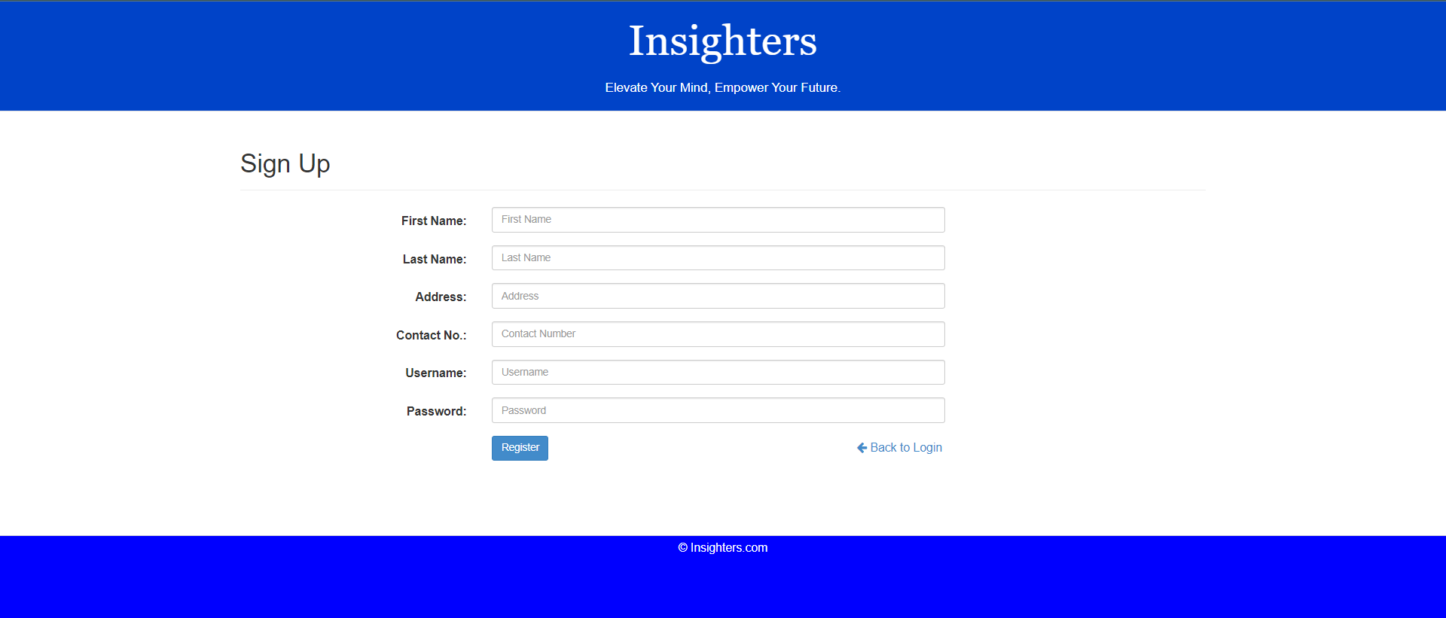
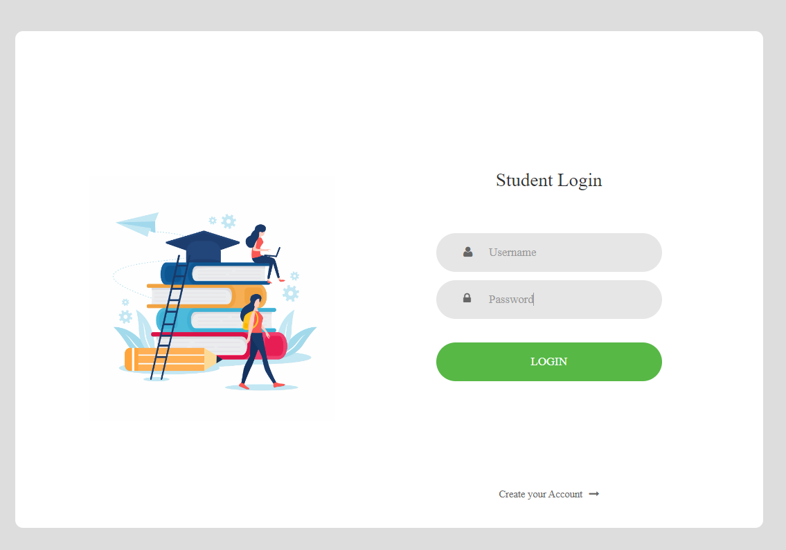
Working User Interface
Login page:
Users create accounts on the e-learning website by providing necessary information such as email, password, and contact details.
User Authentication:
Secure authentication mechanisms are implemented to ensure the security of user
accounts.
Car Listing:
Sellers create listings for the cars they want to sell.
Details typically include make, model, year, mileage, condition, price, and other relevant information.
Sellers may upload images and videos to showcase the car.

Slide 10
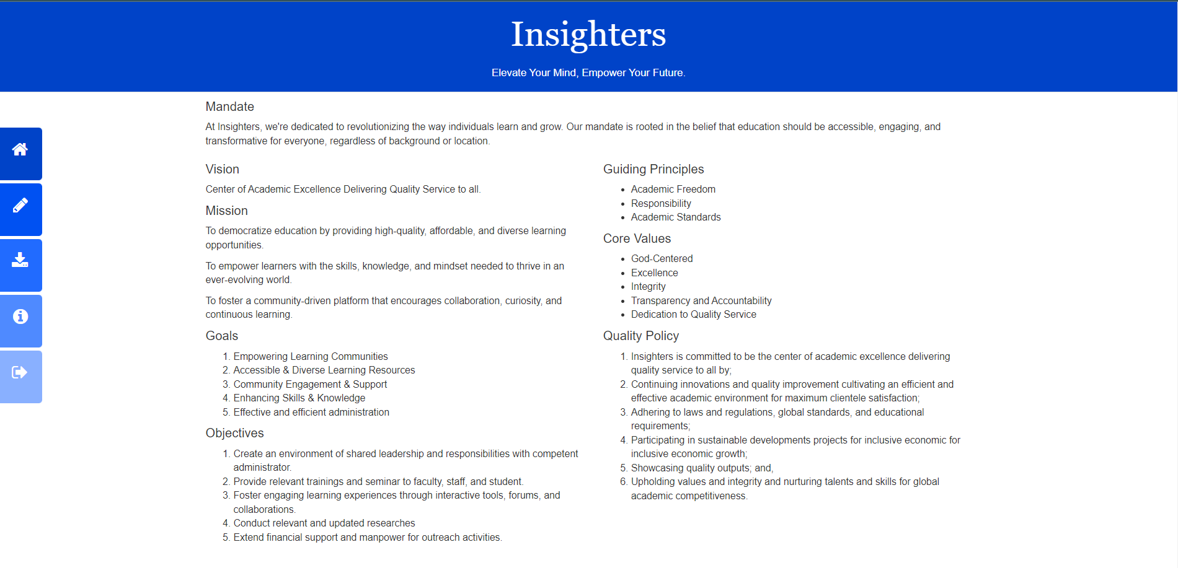
Home Page: It is the home page from student site from where they get all the study material provided by the admin.
Client-Side (Frontend):
User Interface (UI):
The frontend consists of the user interface that buyers and sellers interact with. It includes
web pages, navigation elements, and interactive features.
Client-Side Frameworks:
Utilize frontend frameworks (e.g. HTML, CSS & Js) to enhance the user interface and
provide a dynamic user experience.
Responsive Design:
Ensure the website is accessible and functions well on various devices (desktops, tablets,
smartphones).

Slide 11
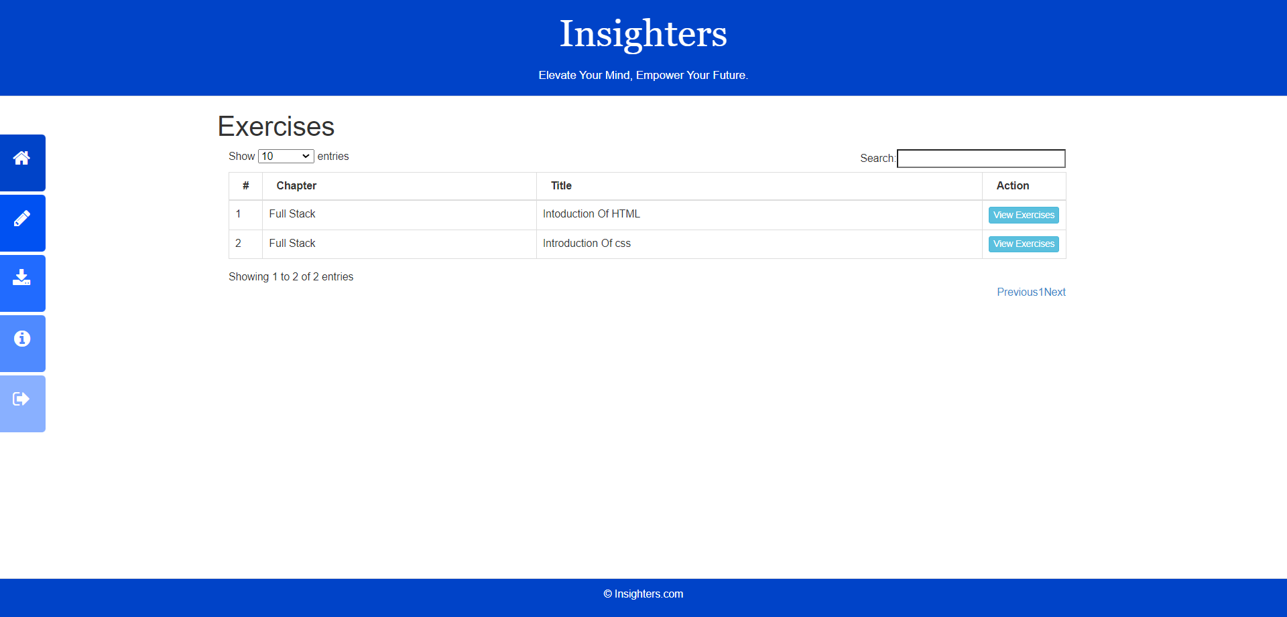

Slide 12
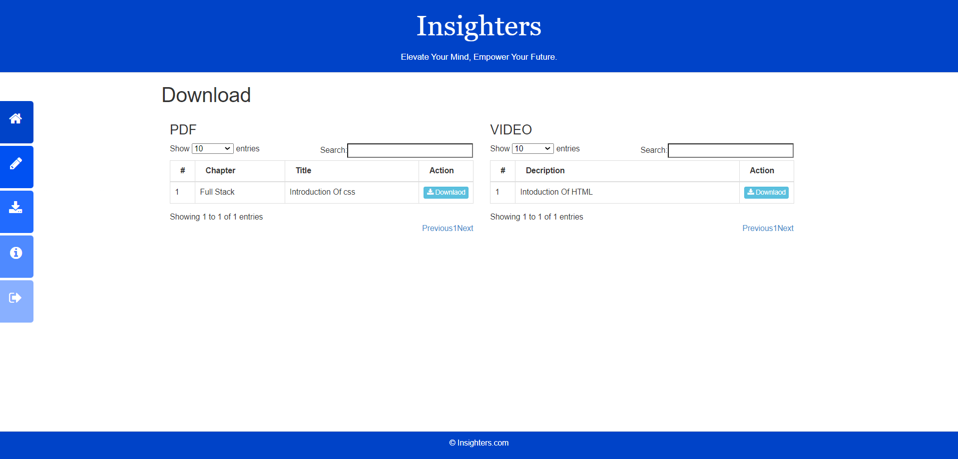

Slide 13
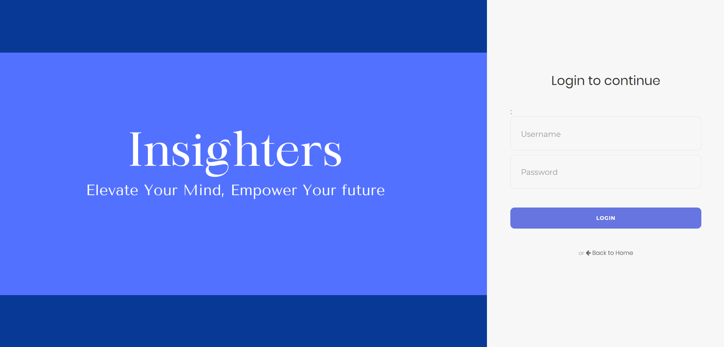
Admin Interface
Login Page:
From tere the admin can login to the website by providing their username and password

Slide 14
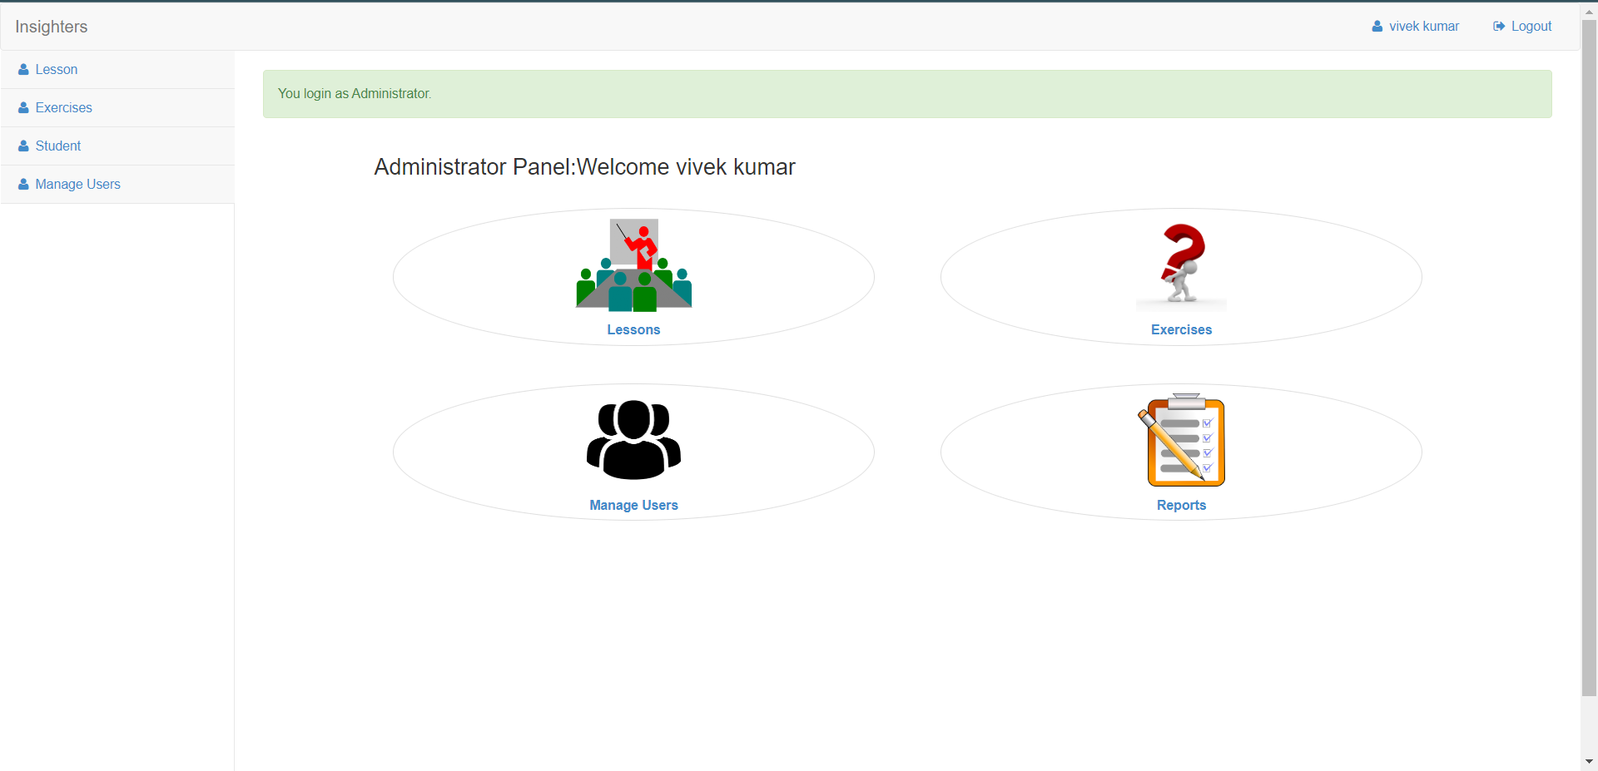
Home Page:
From there admin can provide the study material and take lectures.

Slide 15
Features
Online Presence:
The website will establish your online presence, allowing potential users to find and browse the easy to understand study material.
User Engagement:
Engage users through features like intresing study material, filters, reviews, and comparisons.
Efficient Transactions:
Streamlined online transactions and payment gateways make the buying process more efficient.

Slide 16
Result Analysis
Mobile Responsiveness:
Mobile Traffic: Analyze the proportion of users accessing the site via mobile devices.
Conversion Rate on Mobile: Evaluate how well the mobile version of the website converts visitors into customers.
Customer Support Metrics:
Response Time: Monitor the time taken to respond to user inquiries or support requests.
Customer Satisfaction (CSAT): Collect user feedback to gauge overall satisfaction with the support provided.

Slide 17
Conclusion
E-learning platforms offer a wide range of benefits, including accessibility, flexibility, cost- effectiveness, personalized leaming, enhanced engagement, measurable progress, continuous learning opportunities, professional certifications, environmental sustainability, and data-driven decision-making. These platforms have revolutionized education and training. making learning accessible to a global audience and promoting a culture of continuous, personalized, and environmentally friendly learning. However, the success of e-learning depends on choosing the right platform and effectively designing content to achieve desired outcomes.

Slide 18
References
Wikipedia.com
https://w3school.com/
Google
MND

